Slide 1
LOWPASS FILTER IN
DIGITAL IMAGES PROCESSING
Notes:
Today I’ll be presenting on FUNDAMENTALS OF SPACTIAL FILLTERING
– a fundamental technique used to enhance image quality before deeper analysis.

Slide 2
LOW-PASS FILTER
01
BOX FILTER
02
GAUSSIAN FILTER
03
BILATERAL FILTER
Notes:
In image processing, low-pass filtering smooths the image by retaining low-frequency details and removing high-frequency ones such as edges or noise. The three common filters are Box, Gaussian, and Bilateral.

Slide 3
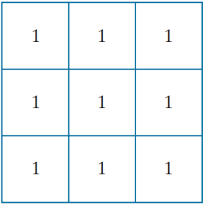
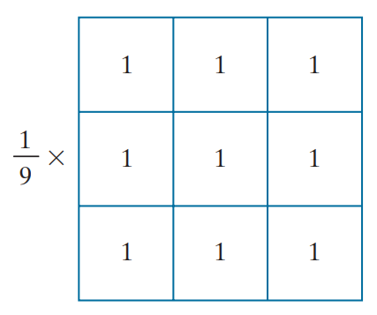
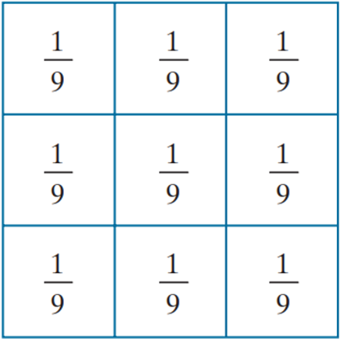
BOX FILTER KERNEL
Normalize
Box filter kernel
Sum of the value of the coefficients = 9
Normalize:
To ensure that the sum of all values in the kernel equals 1.
When applied to a region with uniform intensity (e.g., all pixels have a gray value of 100), the filtered result should retain the same intensity.
To prevent increasing or decreasing the overall brightness of the image (i.e., to avoid altering the overall color balance).
Notes:
The simplest, separable lowpass filter kernel is the box kernel, whose coefficients of kernel have the same value (typically 1)

Slide 4




BOX FILTER KERNEL
Test pattern
size 1024x1024 pixels
Filtering with box kernels of sizes 3x3
Filtering with box kernels of sizes 11x11
Filtering with box kernels of sizes 21x21
Notes:
4 Figure shows the results of applying kernel filters of different sizes to a test pattern image of size 1024 × 1024 pixels.
For m = 3, we note a slight overall blurring of the image The filtered image also has a thin gray border, the result of zero-padding the image prior to filtering Using the 11 11 ⋅ kernel resulted in more pronounced blurring throughout the image, including a more prominent dark border
The result with the 21 21 ⋅ kernel shows significant blurring of all components of the image, including the loss of the characteristic shape of some components, including, for example, the small square on the top left and the small character on the bottom left. The result with the 21 21 ⋅ kernel shows significant blurring of all components of the image, including the loss of the characteristic shape of some components, including, for example, the small square on the top left and the small character on the bottom left.

Slide 5
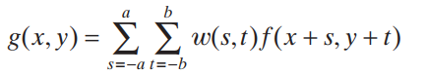
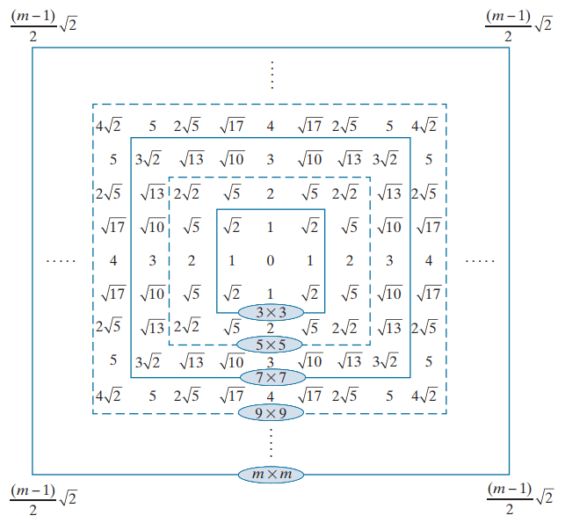
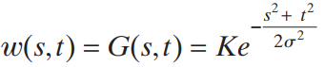
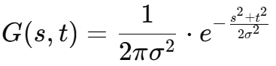
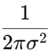
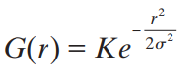
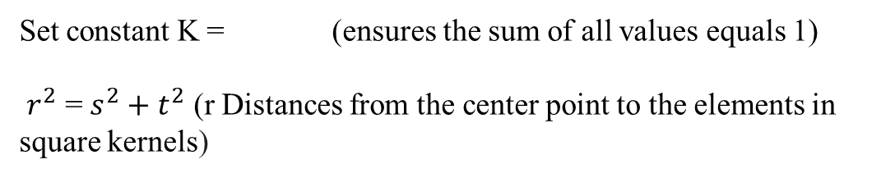
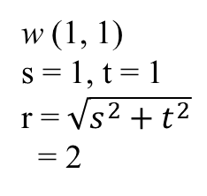
GAUSSIAN FILTER KERNEL
w (1, 1)
s = 1, t = 1
r = $\sqrt{s^{2}+t^{2}}$
= 2
s, t: The pixel coordinates relate to the center of the kernel
σ: The standard deviation (controls the amount of blur)
Set constant K = (ensures the sum of all values equals 1)
$r^{2}$ = $s^{2}+t^{2}$ (r Distances from the center point to the elements in square kernels)
Distances from the center for various sizes of square kernels.
Notes:
A Gaussian kernel filter (or Gaussian blur) is a type of image processing filter used to smooth or blur images and remove noise. It's based on the Gaussian function

Slide 6
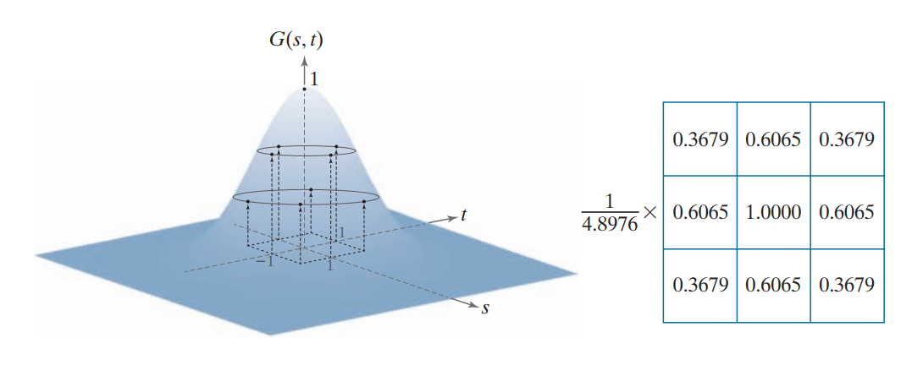
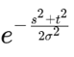
GAUSSIAN FILTER KERNEL
With s = -1 and t = -1
Constant K
Bell shape of the Gaussian function
Sum of the value of the coefficients

Slide 7




Comparing the Box kernel and the Gaussian kernel
Original image
Box kernel 21x21
Gaussian kernel 21x21
Gaussian kernel 43x43
Notes:
Comparing the Box kernel and the Gaussian kernel you'll notice that with kernels of the same size, the box kernel blurs and distorts the shape of the image, while the Gaussian kernel only blurs it. Compared to a 43x43 Gaussian kernel, we see that the level of blur is similar, but when using the Gaussian kernel, the shapes of the details are still preserved. Therefore, in image processing, when the goal is to smooth the image, the Gaussian kernel is more commonly used."

Slide 8
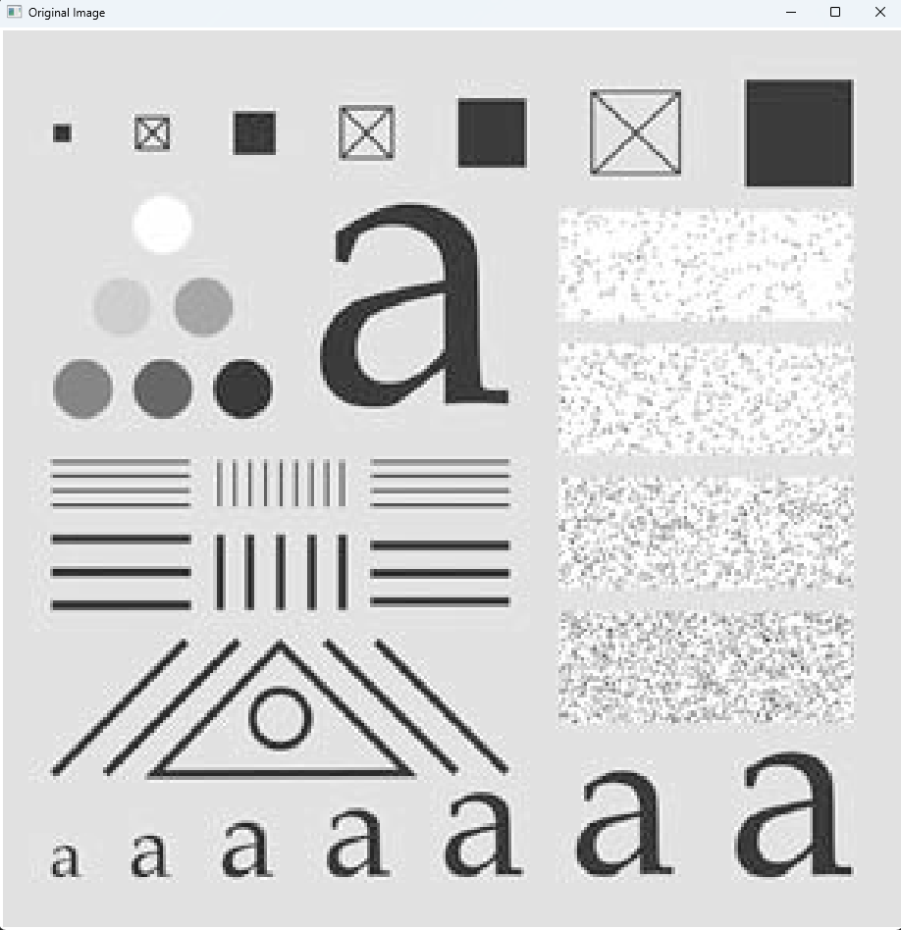
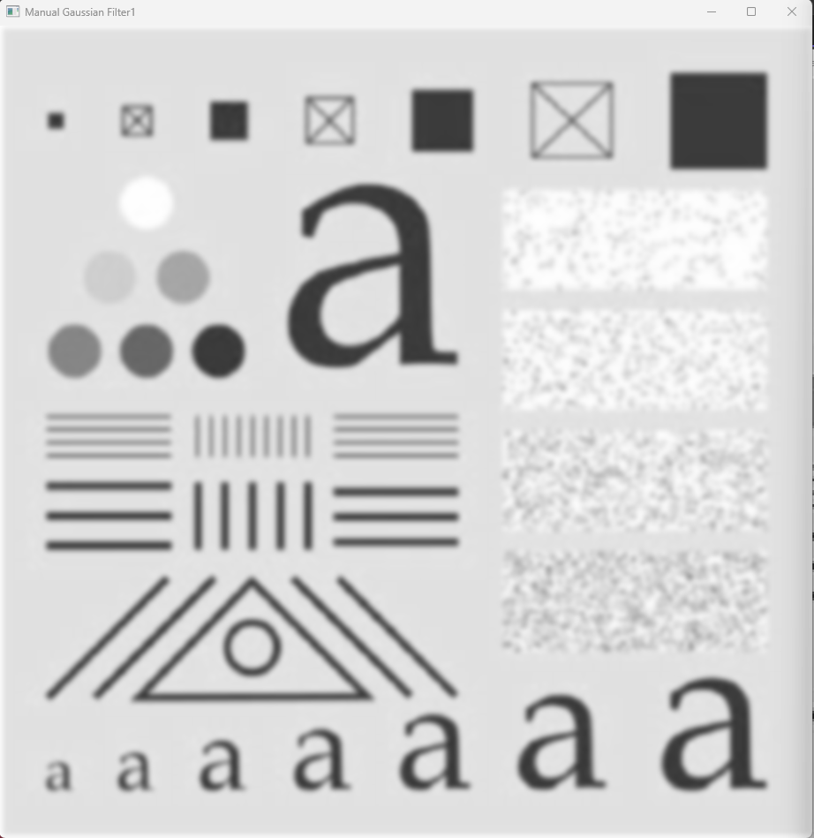

GAUSSIAN FILTER KERNEL
Original Image
Gaussian Filter 25x25, σ = 3.0
Gaussian Filter 25x25, σ = 5.0

Slide 9
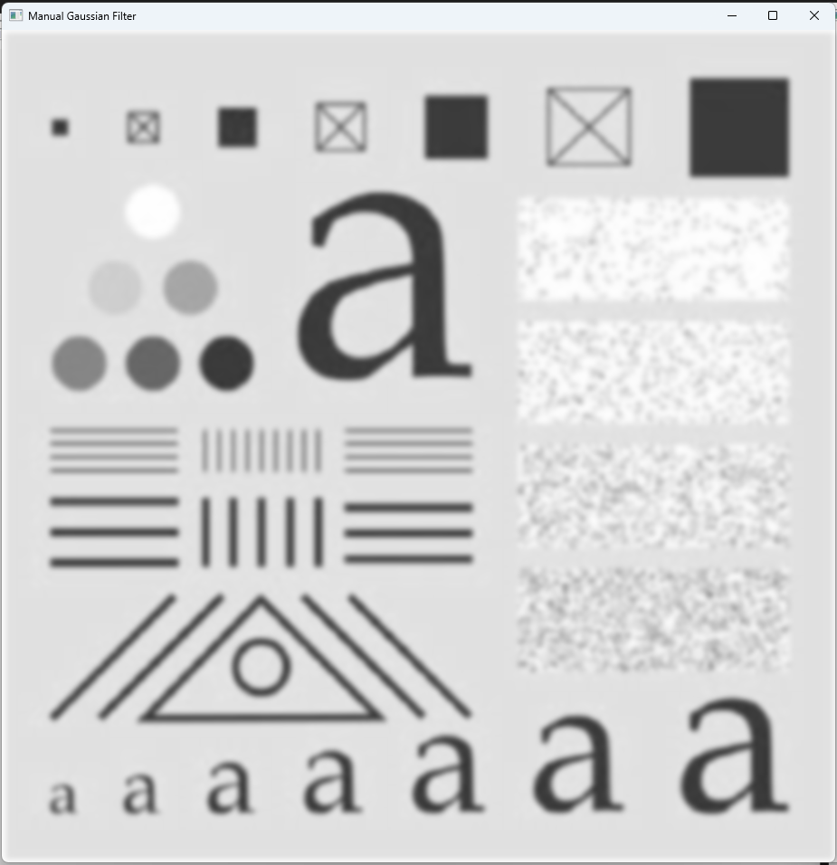

GAUSSIAN FILTER KERNEL
Manual Gaussian Filter
OpenCV Gaussian Filter

Slide 10

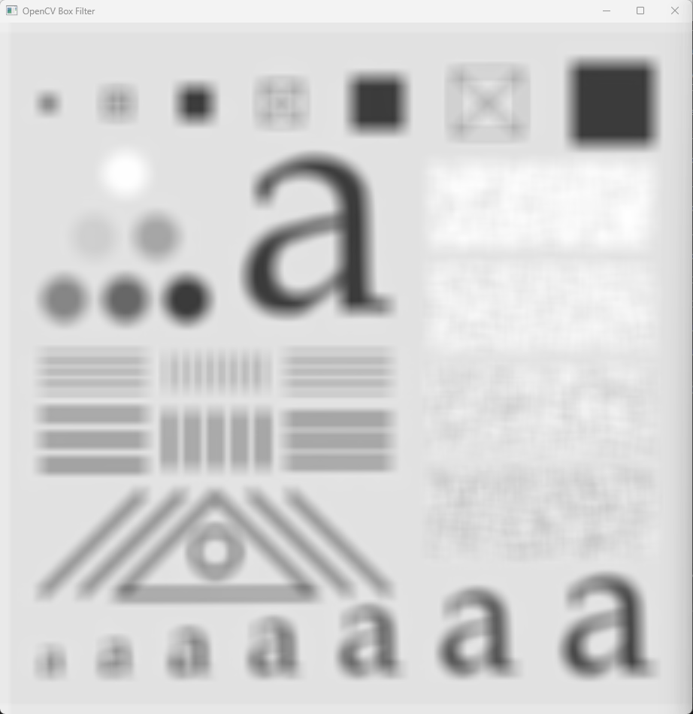
BOX FILTER KERNEL
Manual Box Filter
OpenCV Box Filter

Slide 11



GAUSSIAN FILTER KERNEL
Original Image
Gaussian Kernel 25x25 sigma = 1.0
Gaussian Kernel 25x25 sigma = 5.0

Slide 12

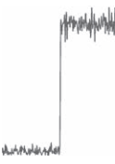
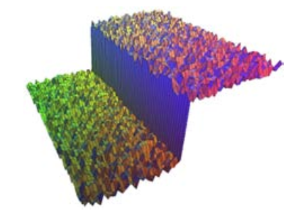
BILATERAL FILTER

Slide 13
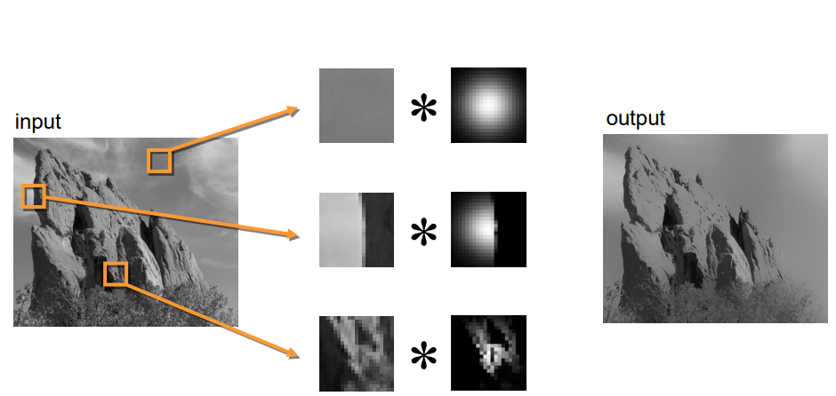
Notes:
The kernel shape depends on the image content

Slide 14
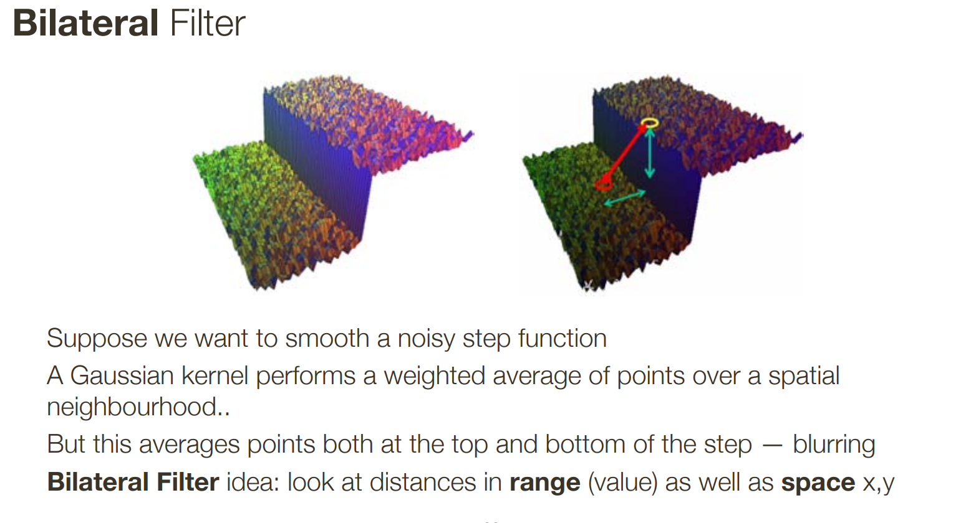

Slide 15
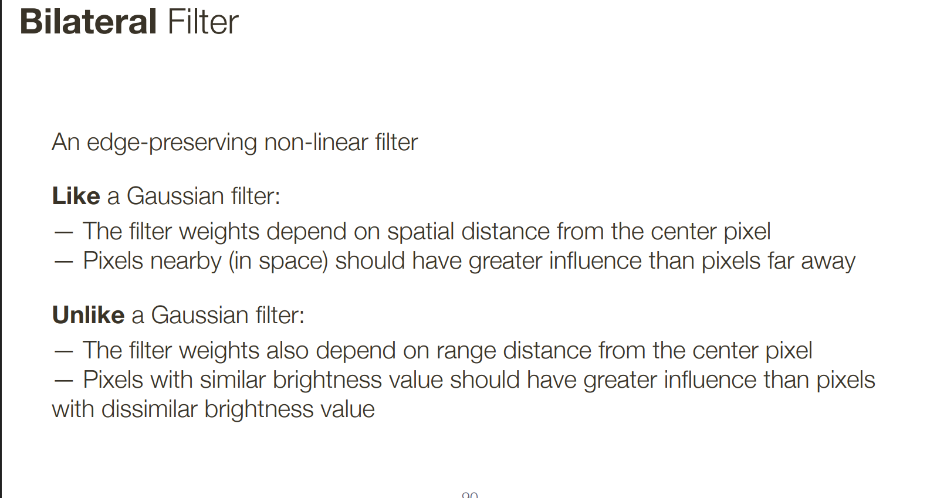

Slide 16
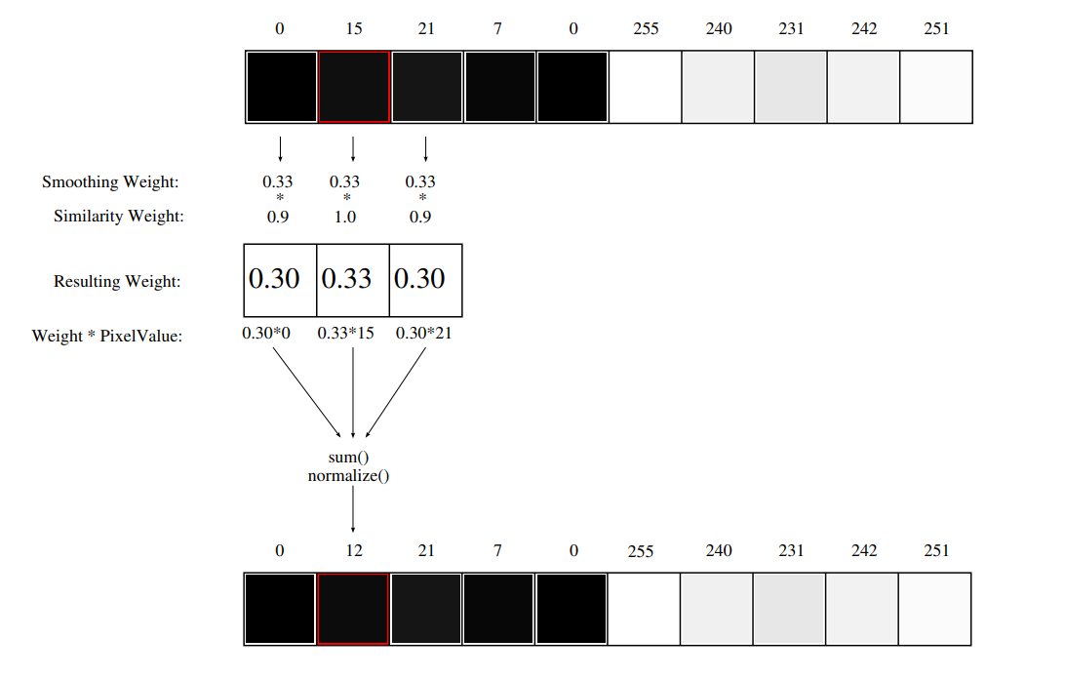
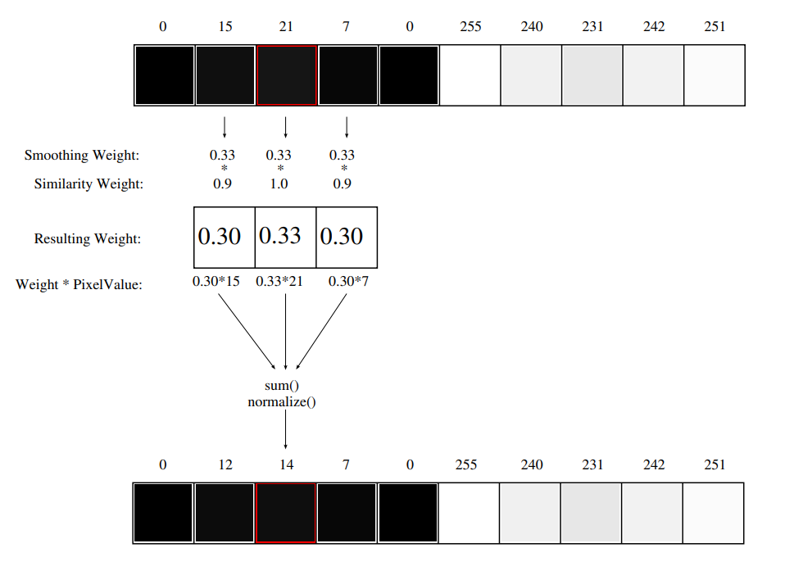

Slide 17
